Slide 1

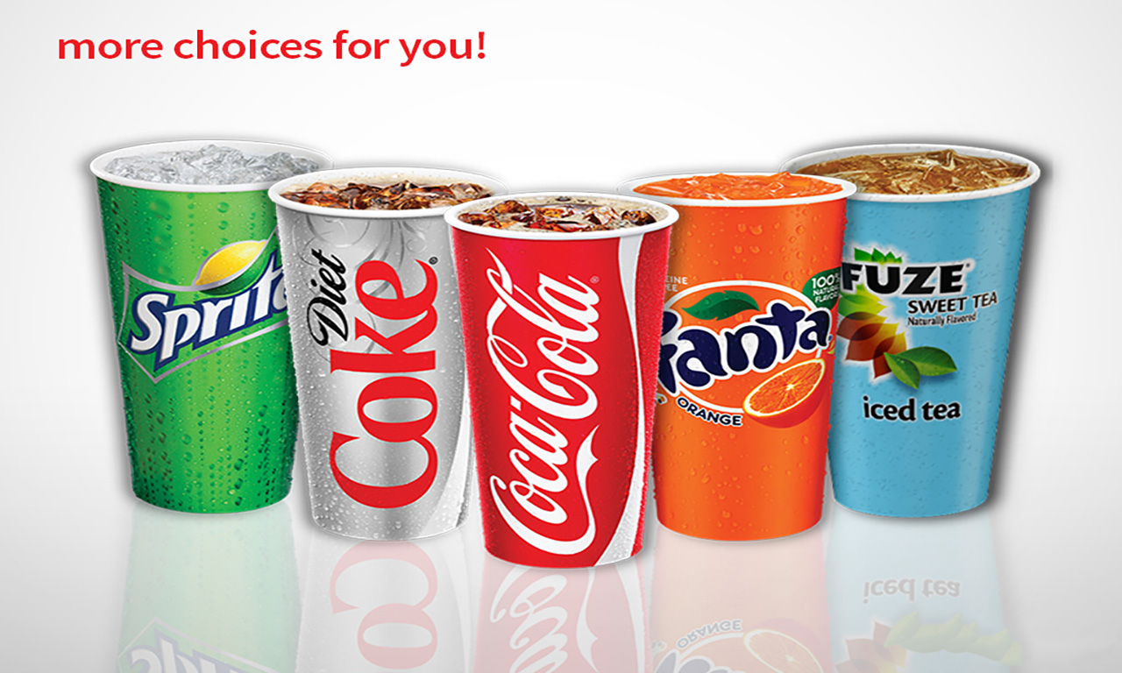



BEVERAGES
DAILY SPECIAL
 | SMALL | Regular
COCACOLA DRINKS 0-380 Cal | 1.69 | 1.99
LEMONADE 165 Cal
BOTTLED WATER 0 Cal |  | 1.49
BOTTLED DRINK 10-230 Cal |  | 2.29
Chicken Teriyaki
640 Cal
6.69
6.39
SERVED WITH: • Mixed Vegetables • Steamed Rice
Extra Chicken
(4 oz.) 170Cal
1.69

Slide 2
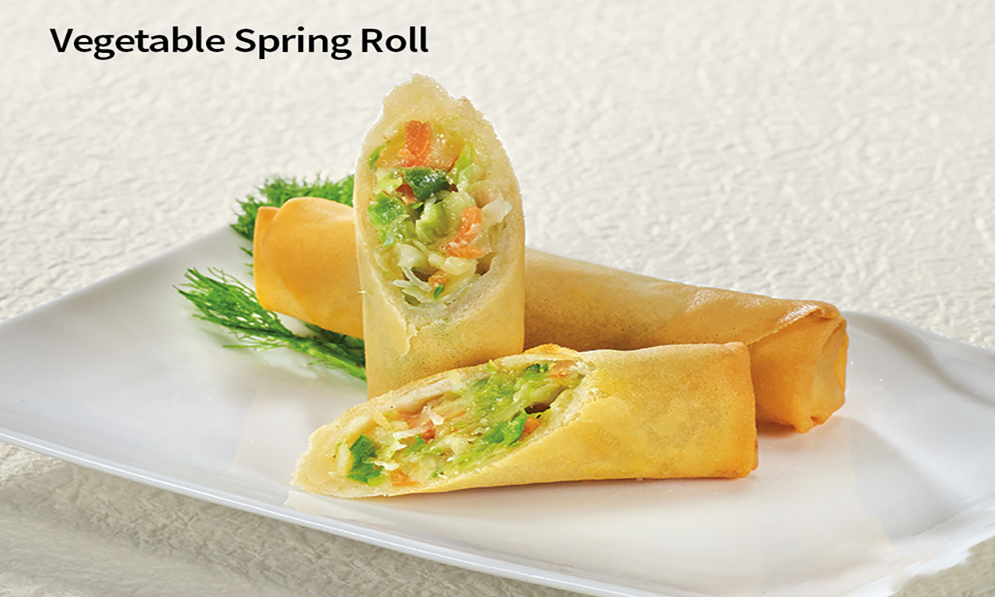
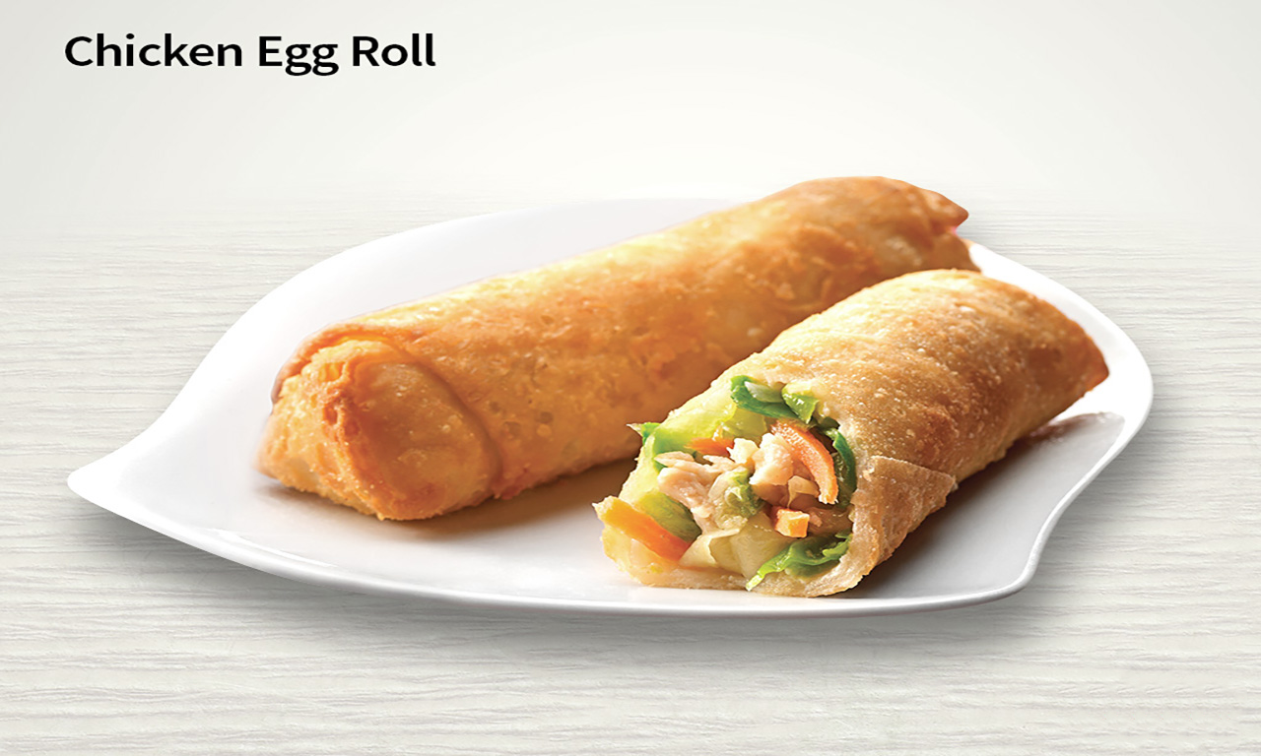

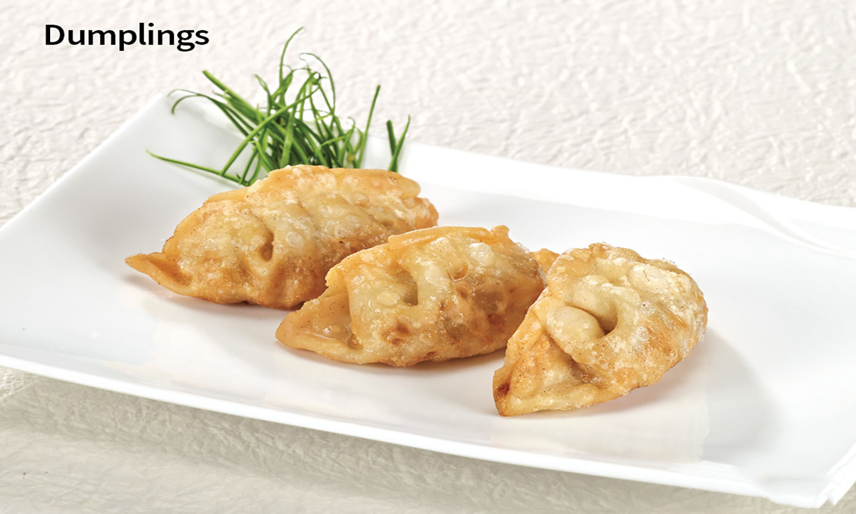
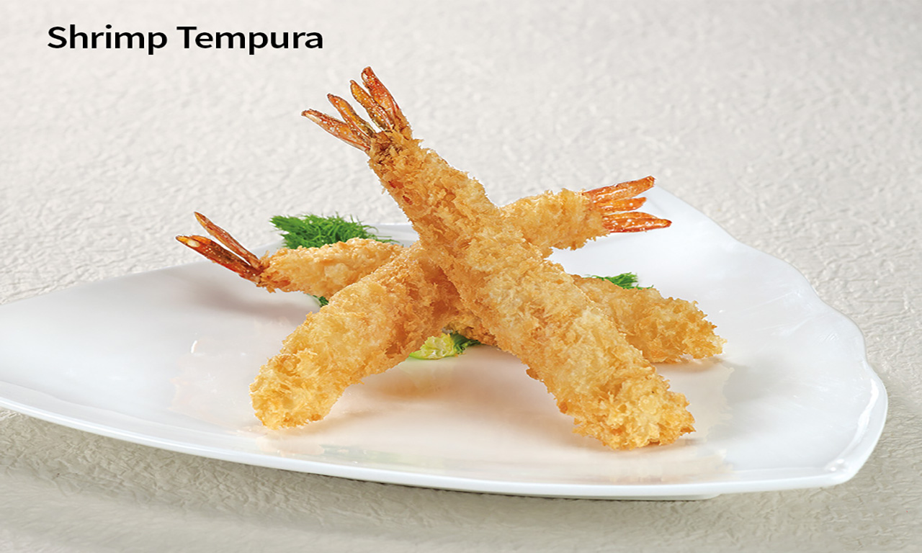




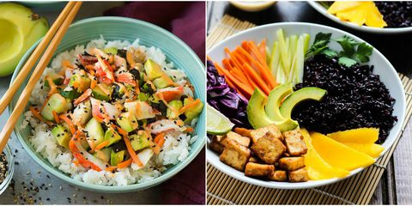
SIDE ORDERS
BEVERAGES
Coke Drinks | Small 0-260 Cal 1.79
 | Regular 0-380 Cal 1.99
Lemonade | 190-250 Cal 1.99
Bottled Water | 0 Cal 1.19
Hot Green Tea | 0 Cal 1.19
Bottle Drink | 10-230 Cal 2.19
190 Cal
0.99
160 Cal
1.39
260 Cal
2.49
390 Cal
3.59
VEGETARIAN
Mixed vegetables & steamed rice
3.49
410 Cal

Slide 3
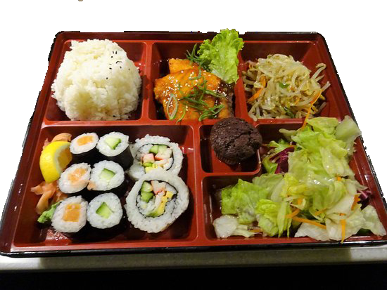
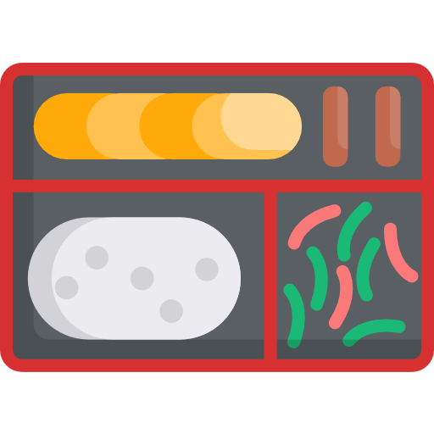


BENTO BOX
Chicken Bento | 930 Cal 8.19
Beef Bento | 810 Cal 8.99
Shrimp Bento | 750 Cal 9.49

Slide 4
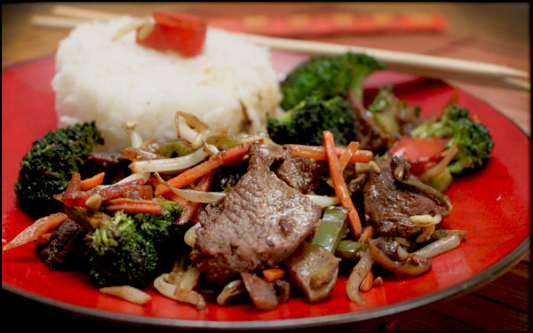
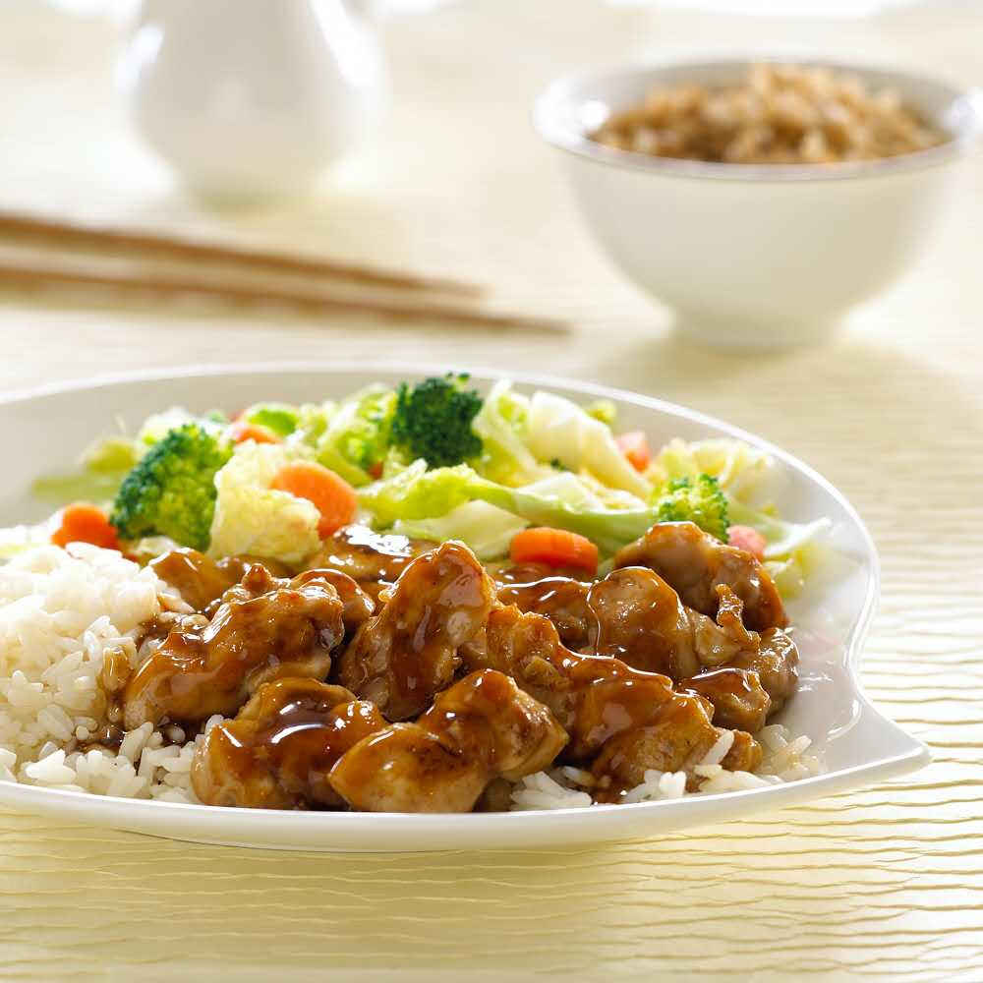
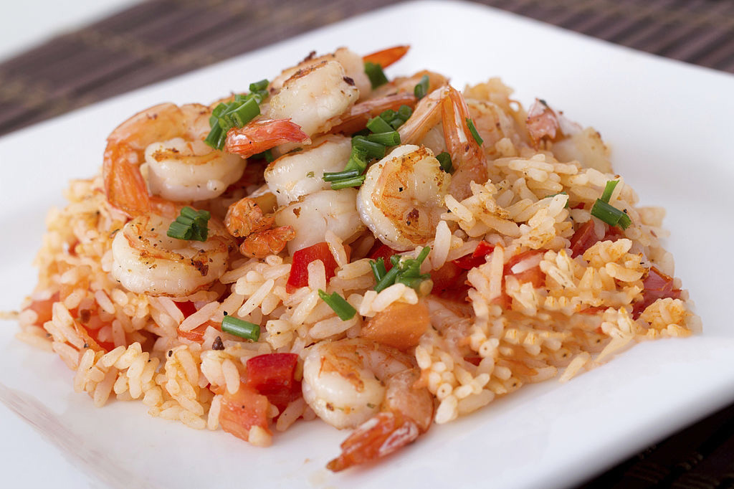

TERIYAKI
SERVED WITH: • Steamed Rice • Mixed Vegetables
1
2
3
4
5

